Slide 1
data types and variables

Slide 2
Python has no command for declaring a variable.
A variable is created the moment you first assign a value to it.
x = 5
y = "John"
print(x)
print(y)

Slide 3
You can get the data type of a variable with the type() function.
x = 5
y = "John"
print(type(x))
print(type(y))

Slide 4
Standard Data Types
The data stored in memory can be of many types. For example, a person's age is stored as a numeric value and his or her address is stored as alphanumeric characters. Python has various standard data types that are used to define the operations possible on them and the storage method for each of them.
Python has five standard data types −
Numbers
String
List
Tuple
Dictionary

Slide 5
Python supports four different numerical types −
int (signed integers)
long (long integers, they can also be represented in octal and hexadecimal)
float (floating point real values)
complex (complex numbers)

Slide 6
Casting
If you want to specify the data type of a variable, this can be done with casting.
x = str(3) # x will be '3'
y = int(3) # y will be 3
z = float(3) # z will be 3.0

Slide 7
Single or Double Quotes?
String variables can be declared either by using single or double quotes:
x = "John"
# is the same as
x = 'John'

Slide 8
Python divides the operators in the following groups:
Arithmetic operators
Assignment operators
Comparison operators
Logical operators
Identity operators
Membership operators
Bitwise operators

Slide 9
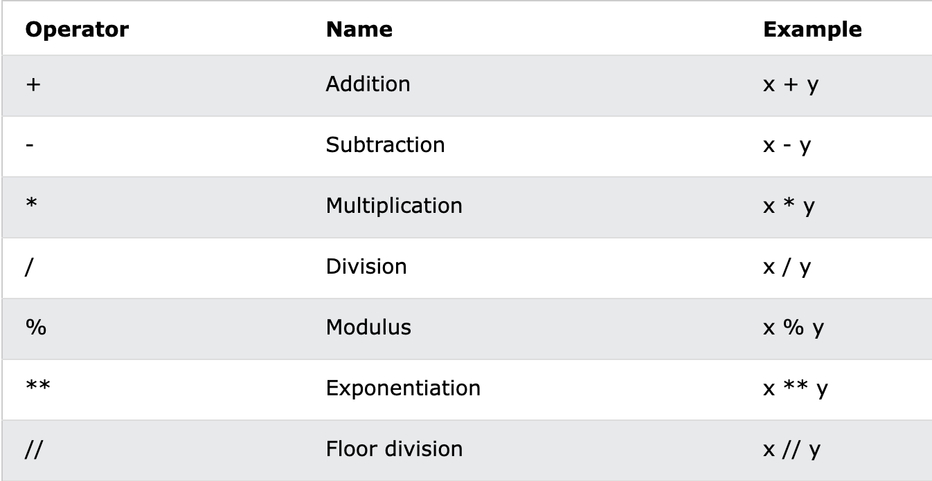
Arithmetic Operators

Slide 10
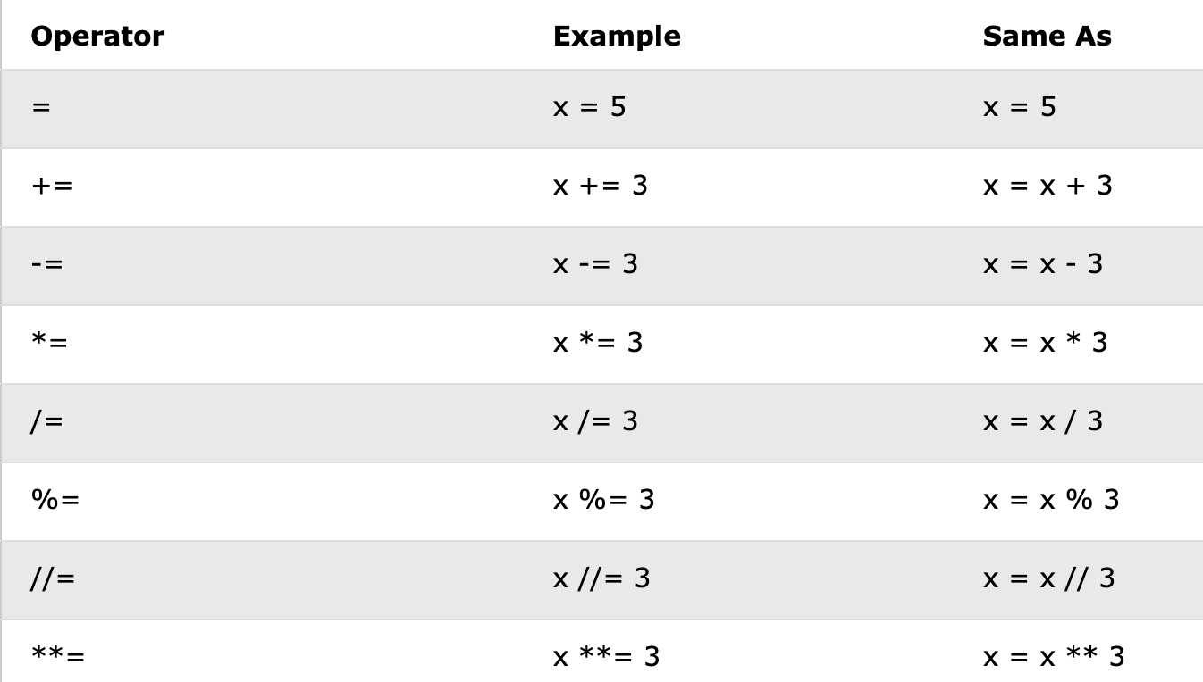
Assignment Operators

Slide 11
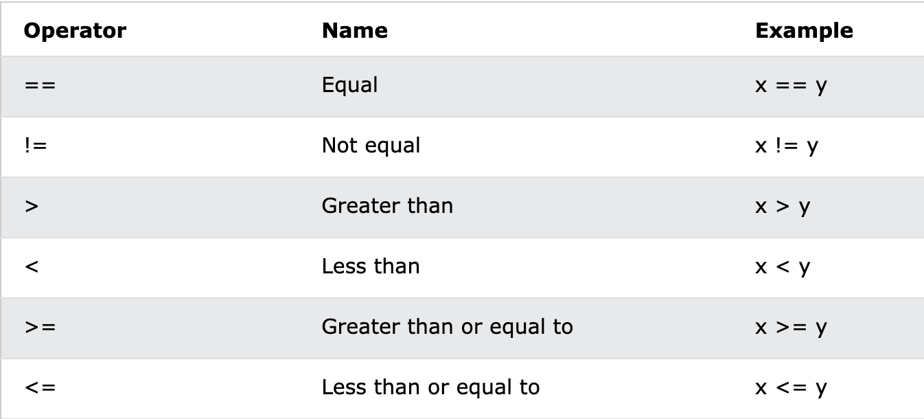
Comparison Operators

Slide 12
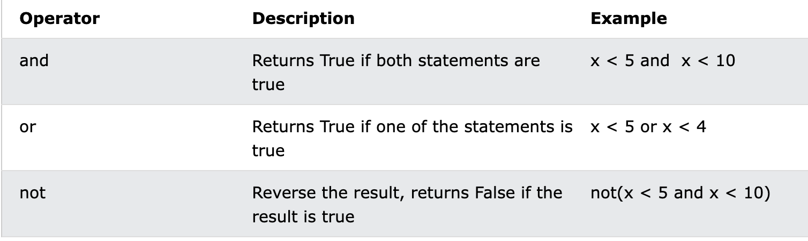
Logical Operators

Slide 13
Decision Making
Decision making is anticipation of conditions occurring while execution of the program and specifying actions taken according to the conditions.
Decision structures evaluate multiple expressions which produce TRUE or FALSE as outcome. You need to determine which action to take and which statements to execute if outcome is TRUE or FALSE otherwise.
Following is the general form of a typical decision making structure found in most of the programming languages −

Slide 14
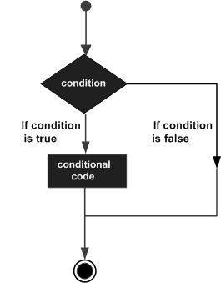

Slide 15
Syntax
if expression:
statement(s)

Slide 16
a = 33
b = 200
if b > a:
print("b is greater than a")

Slide 17
If statement, without indentation (will raise an error):
a = 33
b = 200
if b > a:
print("b is greater than a") # you will get an error

Slide 18
Else
The else keyword catches anything which isn't caught by the preceding conditions.
a = 200
b = 33
if b > a:
print("b is greater than a")
else:
print("b is not greater than a")

Slide 19
Elif
The elif keyword is pythons way of saying "if the previous conditions were not true, then try this condition".
a = 200
b = 33
if b > a:
print("b is greater than a")
elif a == b:
print("a and b are equal")
else:
print("a is greater than b")

